Slide 1

Capstone Project: Why open restaurants in Jacksonville, FL?
John Vera

Slide 2
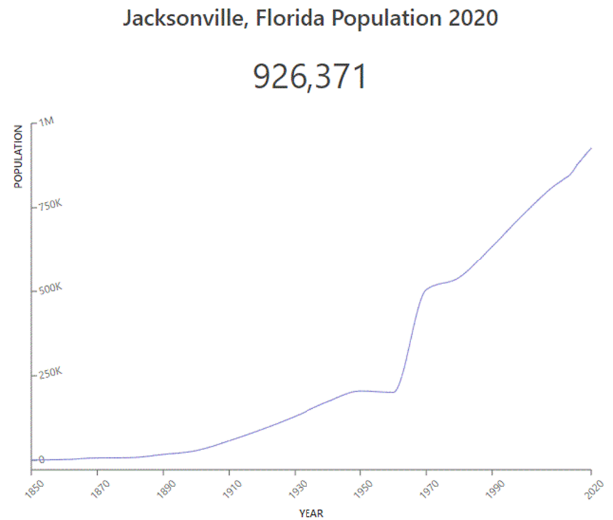
Introduction Description & Discussion of Jacksonville, FL
Jacksonville is the largest city in the continental United States by area and the most populous city in the state of Florida. Spanning over 875 miles, Jacksonville has a population density of 1,239 people per square mile. There are about one million residents, but the population has been growing close to 2% per year.
Two great things about Jacksonville are there are more than 22 miles of white sand beaches just minutes from downtown Jacksonville and it is home to Florida's youngest population drawn to the city's historic neighborhoods, and vibrant nightlife.
Jacksonville also operates the largest urban park system in the United States. A number of parks provide access for people to boat, swim, fish, sail, jet-ski, surf and water-ski. Jacksonville was ranked as the 10th-fastest growing city in the U.S.

Slide 3
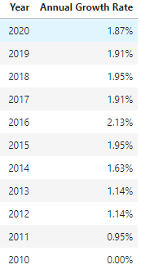
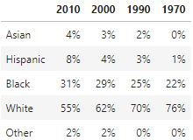
Description & Discussion of Jacksonville, FL
My target audience is stakeholders that are looking for new areas to open restaurants, particularly in Jacksonville, FL. While there are some restaurants most are fast food restaurant chains. There are some Chinese and Mexican restaurants, but there are many other cultures, in Jacksonville. Thai, Filipino, Indian, Caribbean, South American and Ethiopian for example. Given the size and population growth in general, Jacksonville is prime to become truly a great city like that of New York City or Los Angeles. The two fastest growing population segments are Asians and Hispanics. Jacksonville has the country's tenth-largest Arab population and has Florida's largest Filipino American community. Jacksonville is becoming a more diverse city.

Slide 4
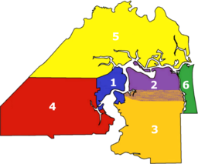
Description & Discussion of Jacksonville, FL
The city is divided into six boroughs divided over 33 zip codes. There are several hundred neighborhoods. Given the amount of neighborhoods, I have limited the analysis to boroughs and zip codes.
Below is an image of the six divisions/boroughs of Jacksonville.
Urban Core - big business district, hospitals and hotels
Arlington - residential
Southside - residential
Westside - some development mostly rural.
Northside some development mostly rural.
Beaches - residential

Slide 5
Data
Below is a explanation of where data and reference information was obtained.
I found the population by zip code from https://www.zipdatamaps.com/zipcodes-jacksonville-fl. For this I created a file called JVilleZipsPop.csv. The zips are used to create markers on the matplotlib graph of Jacksonville.
I obtained a list of latitude and longitude coordinates for the zip codes in Jacksonville from https://www.unitedstateszipcodes.org/zip-code-database/. I downloaded a file called Geospatial_Coordinates.csv. I obtained the coordinates using the zip codes from above.
I merged the data from the two files above on Zip Codes and used this to obtain venue category data using the Foursquare API. https://developer.foursquare.com/places
To analyze the data obtained from the Foursquare API, I used the unsupervised learning algorithm of k-means clustering. The best number of clusters K is obtained using the elbow method. I then graphed the clusters found over a map of Jacksonville.

Slide 6
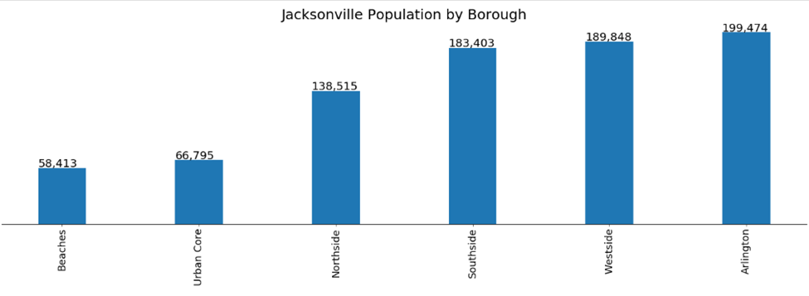
Methodology
I used IBM Skills Network Labs to create notebook. I imported and used various packages like beautifulsoup4, requests, Numpy, Pandas and Matplotlib to analyze data on the Boroughs, Zip Codes, Latitude and Longitude information for Jacksonville. I also looked at the population for each borough to find where most populous areas.

Slide 7
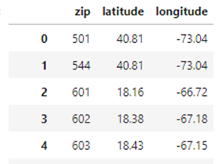
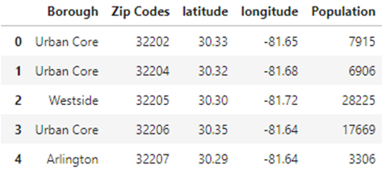
Methodology
Latitude and longitude data by zip code sample.
Merge Neighborhood dataframe and geospatial data for Jacksonville sample.

Slide 8
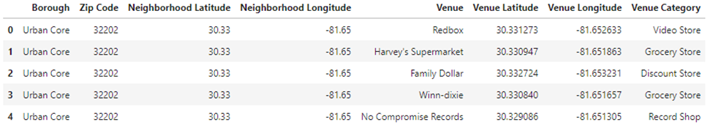
Methodology
Use the zip code data with Foursquare data to find venues by Jacksonville zip code.

Slide 9
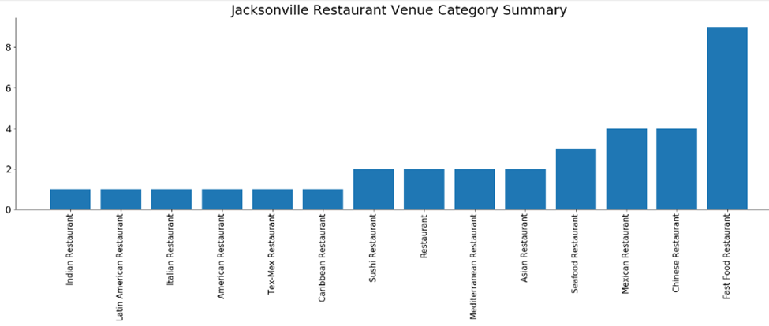
Methodology
Below is summary of the restaurant venue category. The majority of the restaurants are fast food.

Slide 10
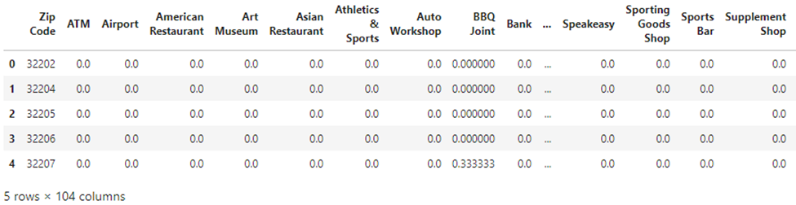
Methodology
One hot encoding - the get_dummies() function is used to convert categorical variable into dummy/indicator variables. There were 103 categories. Below is a sample.

Slide 11
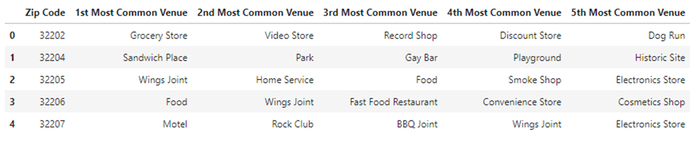
Methodology
Used function to sort in descending order and display the five most common venues by zip code. Below is a sample.

Slide 12

Methodology
k-means Clustering Analysis - I used the elbow method to obtain the optimal K. Below is the elbow method graph. I found k = 7 to be optimal. Also is a sample of the clustering results.

Slide 13
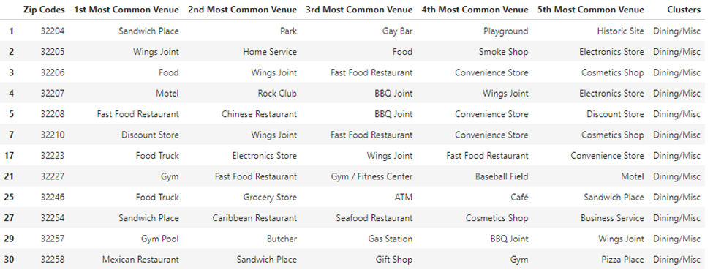
Results
Below are the results of the cluster analysis and graph of the Jacksonville show the clusters.
Cluster 1 Dining/Misc

Slide 14
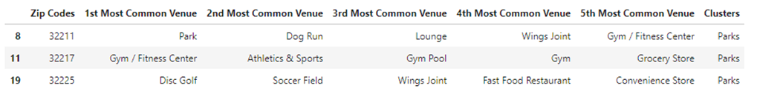
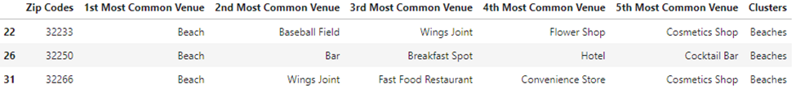
Results
Cluster 2 Parks
Cluster 3 Harbor/Marina
Cluster 4 Beaches

Slide 15
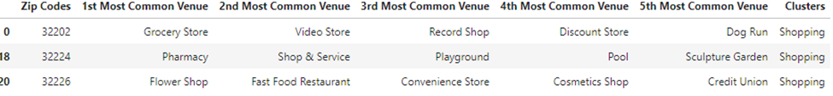
Results
Cluster 5 Shopping
Cluster 6 Business Services
Cluster 7 Airport (JAX International Airport)

Slide 16
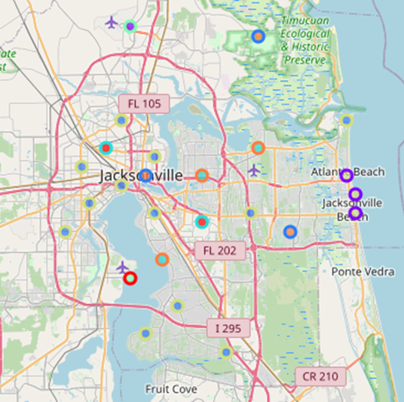
Results
Final Matplotlib graph of Jacksonville with k-means clustering markers

Slide 17
Discussion
Jacksonville is the largest city in the United States by area and has been growing steadily over the last decade and has been becoming more diverse. Also, there are miles of beaches and home to one of the youngest populations is Florida.
Looking over the clusters, most of the dining options are fast food, wing joints and BBQ options. I also noticed but not many Mexican, Chinese and a Seafood restaurant. There are not many options. There are many other types of food.
While the Northside has a large population, it is mostly industrial and rural. I do not think this would be a great area for restaurants, at least not initially. The best areas are Arlington, Southside, Urban Core, Westside, and the Beaches as they are near the beaches and the St John's river, which offer waterfront views as they are highly developed.
Further analysis, could involve population growth and average income by zip code to better decide location.

Slide 18
CONCLUSION
The purpose of this report was to convince restaurant entrepreneurs to take a chance with Jacksonville.
I have shown the growth in population and diversity, as well as, shown the lack of options for dining. There are many areas with either beachfront or riverfront views, as well as, a vibrant downtown and youthful population.
Jacksonville welcomes restaurant entrepreneurs to embark on a new venture to greatly enhance the dining experiences available.
Food is the way to most people’s hearts.

